Slide 1

Bank Loan Case Study
Author: Sheevam Chakraborty

Slide 2
Project Description
Context of Finance Company - Examining lending information for a finance company that specializes in loans to urban clients.
Credit Risk Challenge - Managing the problem of customer defaults due to insufficient credit history.
Data Analyst Role - Identifying patterns in the data through the application of Exploratory Data Analysis (EDA).
Objective - Making sure that eligible loan applicants aren't turned down because of a complex examination of data patterns.
Risk Mitigation Focus - Using EDA insights to improve decision-making, reduce defaults, and optimize loan eligibility processes

Slide 3
Approach and Tech Stack
Excel Data Import and Cleaning - Enter lending information into Microsoft Excel. Cleanse the data to remove outliers, inconsistent values and missing values
Descriptive Statistics in Excel - For understanding important variables like credit history, loan amounts and applicant demographics, use Excel functions for descriptive statistics
Examining Data with Excel (EDA) - Execute EDA to find trends and patterns in loan defaults. Determine the factors influencing defaults with statistical measures
Excel spreadsheets for correlation analysis and hypothesis testing - Find relationships between applicant profiles, credit histories and loan defaults. Use hypothesis testing to verify significant correlations and patterns
Insight Presentation and Recommendations - Create a thorough report by collecting insights from Excel analyses. Make practical suggestions for simplifying the loan approval process to minimize default risks

Slide 4
Hypothesis
Demographic Factors:
Gender & Payment Difficulty: Male clients might exhibit different payment behaviours than female clients.
Income & Payment Difficulty: Clients with lower total incomes might face more challenges in making timely payments.
Age & Payment Difficulty: Younger clients might face more payment difficulties than older clients.
Loan Characteristics:
Loan Amount & Payment Difficulty: Higher loan amounts might be associated with increased payment difficulties.
Occupation:
Occupation Type & Payment Difficulty: Some occupation types might be associated with increased payment difficulties.

Slide 5
Property & Reality:
Property Ownership & Payment Difficulty: Clients who own real estate or a car might face different payment challenges than those who don't.
Family Status:
Family Size & Payment Difficulty: Clients with larger families (more children or dependents) might face more payment difficulties.
Regional Factors:
Client's Region & Payment Difficulty: Clients from certain regions or with specific regional ratings might exhibit different payment behaviours.
Previous Application Details (from previous_application.csv):
Previous Loan Purpose & Current Payment Difficulty: The purpose of previous loans might influence the likelihood of payment difficulties for the current loan. For instance, if a previous loan was for urgent medical needs, the client might face more financial strain.

Slide 6
Insights
Let’s get started with the questions then
We have five objectives to work on this time

Slide 7
A. Identify Missing Data and Deal with it Appropriately: As a data analyst, you come across missing data in the loan application dataset. It is essential to handle missing data effectively to ensure the accuracy of the analysis.
Task: Identify the missing data in the dataset and decide on an appropriate method to deal with it using Excel built-in functions and features
Applications
32 columns, 40,773 rows
Previous Applications
20 columns, 50,000 rows
List of deleted columns from Application workbook
OWN_CAR_AGE FLAG_MOBIL FLAG_EMP_PHONE FLAG_WORK_PHONE FLAG_CONT_MOBILE OCCUPATION_TYPE REGION_RATING_CLIENT_W_CITY WEEKDAY_APPR_PROCESS_START REG_REGION_NOT_LIVE_REGION REG_REGION_NOT_WORK_REGION LIVE_REGION_NOT_WORK_REGION REG_CITY_NOT_LIVE_CITY REG_CITY_NOT_WORK_CITY LIVE_CITY_NOT_WORK_CITY EXT_SOURCE_1 EXT_SOURCE_2 EXT_SOURCE_3 APARTMENTS_AVG BASEMENTAREA_AVG YEARS_BEGINEXPLUATATION_AVG YEARS_BUILD_AVG COMMONAREA_AVG ELEVATORS_AVG ENTRANCES_AVG FLOORSMAX_AVG FLOORSMIN_AVG LANDAREA_AVG LIVINGAPARTMENTS_AVG LIVINGAREA_AVG NONLIVINGAPARTMENTS_AVG NONLIVINGAREA_AVG APARTMENTS_MODE BASEMENTAREA_MODE YEARS_BEGINEXPLUATATION_MODE YEARS_BUILD_MODE COMMONAREA_MODE ELEVATORS_MODE ENTRANCES_MODE FLOORSMAX_MODE FLOORSMIN_MODE LANDAREA_MODE LIVINGAPARTMENTS_MODE LIVINGAREA_MODE NONLIVINGAPARTMENTS_MODE NONLIVINGAREA_MODE APARTMENTS_MEDI BASEMENTAREA_MEDI YEARS_BEGINEXPLUATATION_MEDI YEARS_BUILD_MEDI COMMONAREA_MEDI ELEVATORS_MEDI ENTRANCES_MEDI FLOORSMAX_MEDI FLOORSMIN_MEDI LANDAREA_MEDI LIVINGAPARTMENTS_MEDI LIVINGAREA_MEDI NONLIVINGAPARTMENTS_MEDI NONLIVINGAREA_MEDI FONDKAPREMONT_MODE HOUSETYPE_MODE TOTALAREA_MODE WALLSMATERIAL_MODE EMERGENCYSTATE_MODE FLAG_DOCUMENT_2 FLAG_DOCUMENT_3 FLAG_DOCUMENT_4 FLAG_DOCUMENT_5 FLAG_DOCUMENT_6 FLAG_DOCUMENT_7 FLAG_DOCUMENT_8 FLAG_DOCUMENT_9 FLAG_DOCUMENT_10 FLAG_DOCUMENT_11 FLAG_DOCUMENT_12 FLAG_DOCUMENT_13 FLAG_DOCUMENT_14 FLAG_DOCUMENT_15 FLAG_DOCUMENT_16 FLAG_DOCUMENT_17 FLAG_DOCUMENT_18 FLAG_DOCUMENT_19 FLAG_DOCUMENT_20 FLAG_DOCUMENT_21 AMT_REQ_CREDIT_BUREAU_HOUR AMT_REQ_CREDIT_BUREAU_DAY AMT_REQ_CREDIT_BUREAU_WEEK AMT_REQ_CREDIT_BUREAU_MON AMT_REQ_CREDIT_BUREAU_QRT AMT_REQ_CREDIT_BUREAU_YEAR

Slide 8
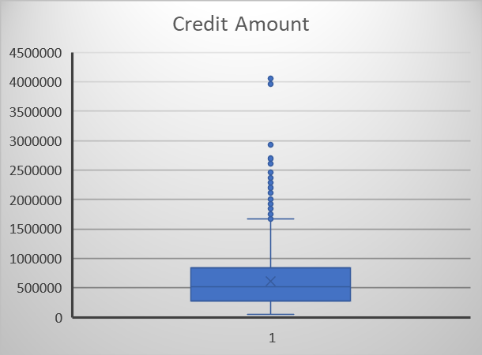
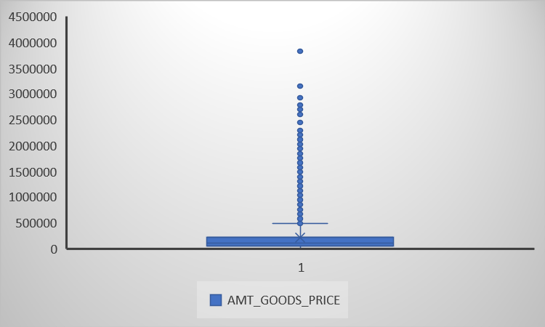
B. Identify Outliers in the Dataset: Outliers can significantly impact the analysis and distort the results. You need to identify outliers in the loan application dataset.
Task: Detect and identify outliers in the dataset using Excel statistical functions and features, focusing on numerical variables.
Applications
32 columns, 40,773 rows
Previous Applications
20 columns, 50,000 rows

Slide 9
C. Analyze Data Imbalance: Data imbalance can affect the accuracy of the analysis, especially for binary classification problems. Understanding the data distribution is crucial for building reliable models.
Task: Determine if there is data imbalance in the loan application dataset and calculate the ratio of data imbalance using Excel functions.
Applications
32 columns, 40,773 rows
Previous Applications
20 columns, 50,000 rows

Slide 10
D. Perform Univariate, Segmented Univariate, and Bivariate Analysis: To gain insights into the driving factors of loan default, it is important to conduct various analyses on consumer and loan attributes.
Task: Perform univariate analysis to understand the distribution of individual variables, segmented univariate analysis to compare variable distributions for different scenarios, and bivariate analysis to explore relationships between variables and the target variable using Excel functions and features.
Applications
32 columns, 40,773 rows
Previous Applications
20 columns, 50,000 rows
Univariate Analysis
 | CNT_CHILDREN | AMT_INCOME_TOTAL | AMT_CREDIT | AMT_ANNUITY | AMT_GOODS_PRICE
mean | 0.50 | 178473.04 | 612778.02 | 27877.52 | 550201.93
median | 0.00 | 157500.00 | 521280.00 | 25960.50 | 450000.00
mode | 0.00 | 135000.00 | 450000.00 | 9000.00 | 450000.00
range | 11.00 | 116974350.00 | 4005000.00 | 255973.50 | 4005000.00
std dev | 0.77 | 587451.67 | 405812.74 | 14742.28 | 373054.26
variance | 0.59 | 345099464241.57 | 164683983341.20 | 217334961.49 | 139169479662.83

Slide 11
Bivariate Analysis
Applications
32 columns, 40,773 rows
Previous Applications
20 columns, 50,000 rows

Slide 12
E. Identify Top Correlations for Different Scenarios: Understanding the correlation between variables and the target variable can provide insights into strong indicators of loan default.
Task: Segment the dataset based on different scenarios (e.g., clients with payment difficulties and all other cases) and identify the top correlations for each segmented data using Excel functions.
Applications
32 columns, 40,773 rows
Previous Applications
20 columns, 50,000 rows
Correlation Matrix with Heat Map
Target 1 (DEFAULTER) | CNT_CHILDREN | AMT_INCOME_TOTAL | AMT_CREDIT | AMT_ANNUITY | AMT_GOODS_PRICE | REGION_POPULATION_RELATIVE | Age | CNT_FAM_MEMBERS | REGION_RATING_CLIENT | DEF_30_CNT_SOCIAL_CIRCLE | DEF_60_CNT_SOCIAL_CIRCLE
CNT_CHILDREN | 1
AMT_INCOME_TOTAL | -0.030411677 | 1
AMT_CREDIT | 0.009645704 | 0.311445675 | 1
AMT_ANNUITY | 0.01123647 | 0.3713188 | 0.745055477 | 1
AMT_GOODS_PRICE | 0.002144239 | 0.313428484 | 0.982120427 | 0.746788213 | 1
REGION_POPULATION_RELATIVE | -0.018820739 | 0.095908597 | 0.051861792 | 0.061329275 | 0.058418661 | 1
Age | -0.162559089 | 0.089531201 | 0.197146316 | 0.088162963 | 0.19060081 | 0.015390652 | 1
CNT_FAM_MEMBERS | 0.900664182 | -0.02214905 | 0.052652036 | 0.049491281 | 0.048115413 | -0.020944955 | -0.104287027 | 1
REGION_RATING_CLIENT | 0.061990007 | -0.160207729 | -0.046143285 | -0.063209658 | -0.052516777 | -0.434272694 | -0.052665197 | 0.064942398 | 1
DEF_30_CNT_SOCIAL_CIRCLE | -0.006996512 | -0.046072367 | -0.037927318 | -0.037351709 | -0.032484936 | 0.016604761 | 0.001350976 | -0.001395323 | 0.01541248 | 1
DEF_60_CNT_SOCIAL_CIRCLE | -0.012498616 | -0.033596939 | -0.041024916 | -0.041522425 | -0.032871852 | 0.015001485 | 0.009293982 | -0.004047456 | 9.49418E-05 | 0.891433576 | 1

Slide 13
Inference
Female clients ratio for loan application than male but male clients are more keen to be defaulters
Clients with annual income within range 1 – 6 Lakh apply more for loans but clients with annual income below 1 Lakh have higher problems with loan repayment
Clients are more frequent in middle ages (30 -40 years) to be applicants. Young clients face more difficulty with loan repayments
Loan amounts ranging between 1 – 10 Lakhs have encountered the highest ratio of defaulters
Commercial associates face the most difficulties in loan repayment and are prone to be defaulters
Contrary to belief, people who own a car or real estate are higher in the segment of defaulters
People with larger families are less likely to opt for loans, as shown by the data analysis, most of our clients are within the smaller family range. The likelihood of defaulters is higher in clients with small family
Clients who have a good previous track record are more keen to be timely repayors

Slide 14
Link to Workbooks
Application
Previous Application

Slide 15
Thank You!

